Slide 1
Reactive forms
Hari Katakam
UI Lead
COLT, Corporate technology

Slide 2
What are forms
Collection of user inputs and usually will be sent to Server
A job Application
A login page
Adding a Product in a E-commerce Site

Slide 3
Key elements
controls
Text Boxes
Text Areas
Drop down options
Radio Buttons
Check boxes
Custom elements
Validation
Min and Max
Pattern
.. etc

Slide 4
Forms in Angular
Template driven forms
Template Driven Forms we specify behaviors/validations using directives and attributes in our template
All things happen in Templates
Reactive forms
Reactive forms are forms where we define the structure of the form and validation in the component class
Then, we bind it to the HTML form in the template.

Slide 5
Basic Building blocks
Form group
The FormGroup is a collection of FormControl. It can also contain other FormGroup’s.
Form Control
The FormControl is the basic building block of the Angular Forms. It represents a single input field in an Angular form.
Validators
In built/ Custom

Slide 6
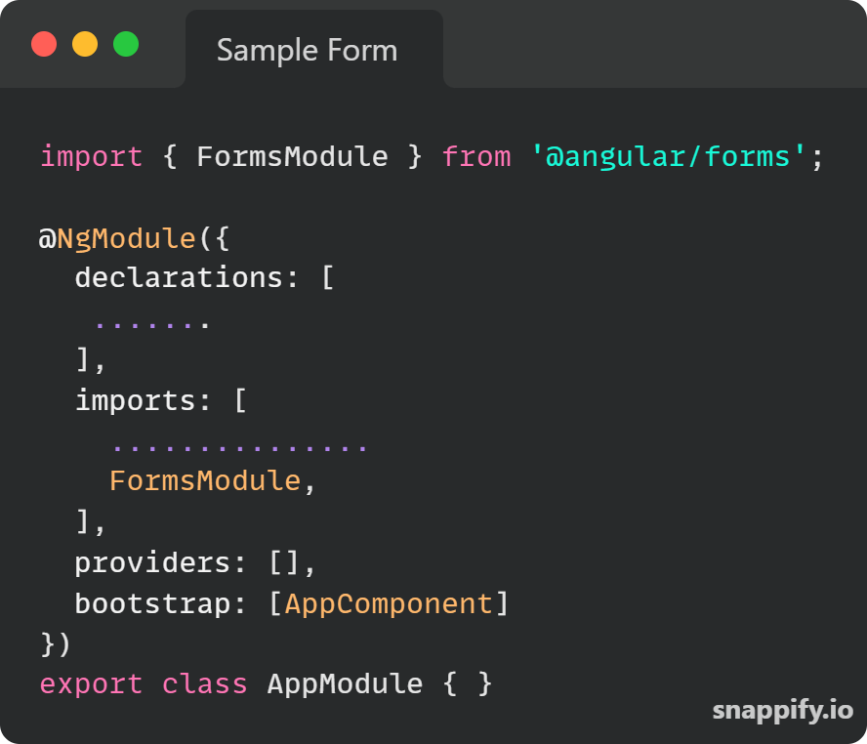
Working with Template driven forms

Slide 7
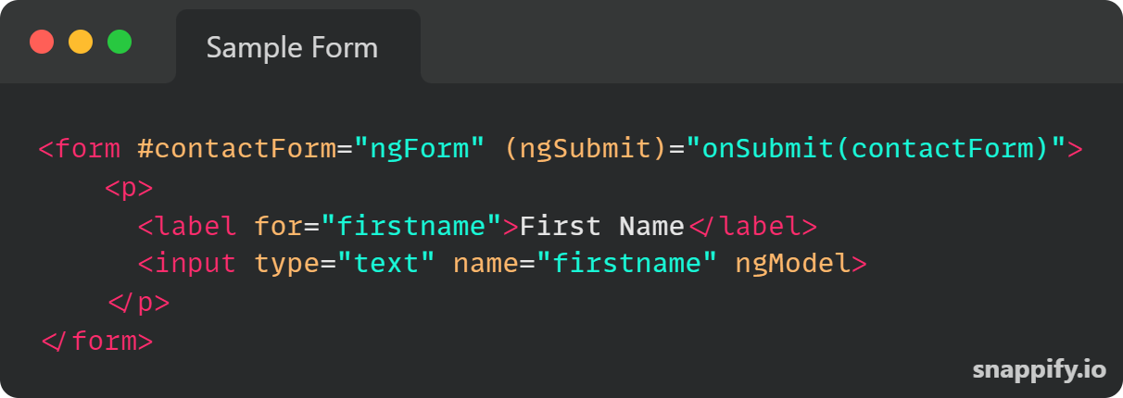
<form #contactForm="ngForm“ ….
Creates a top-level FormGroup instance
We have access to the ngForm instance via the local template variable
<input type="text" name="firstname" ngModel>
ngModel will use the name attribute to create the FormControl instance for each of the Form field it is attached.

Slide 8
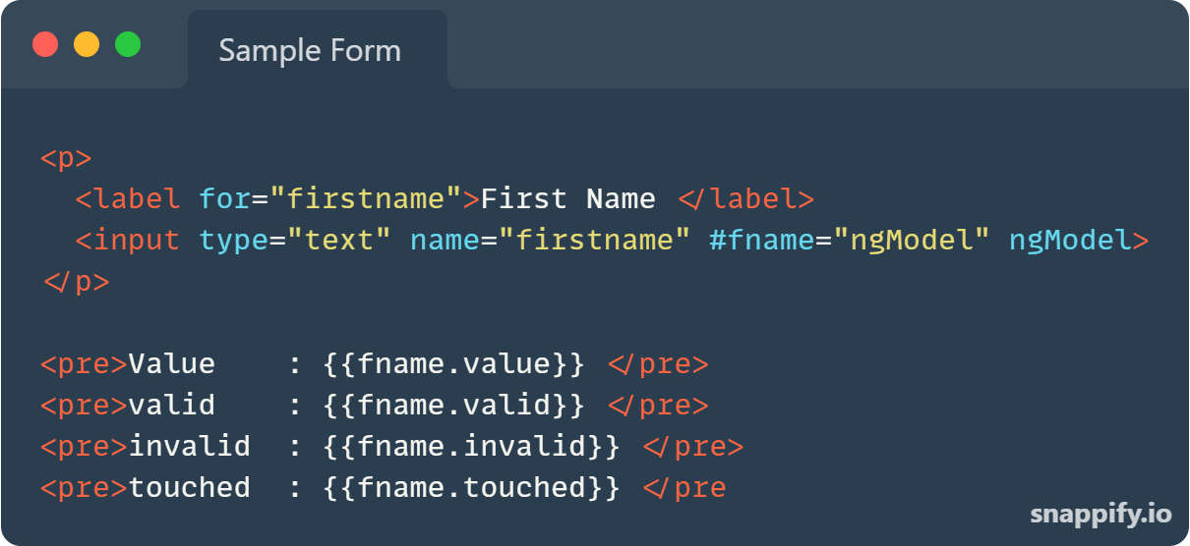

Slide 9
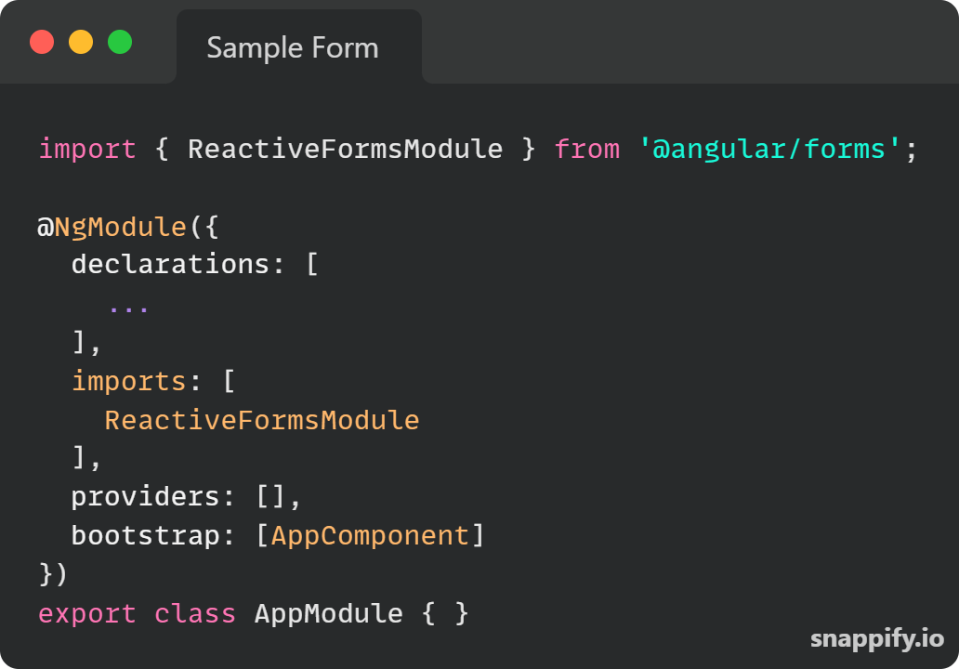
Working with Reactive forms

Slide 10
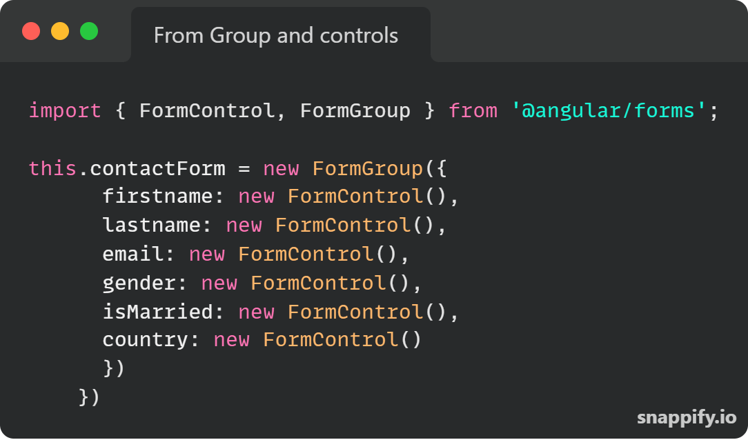
From Group and form control

Slide 11
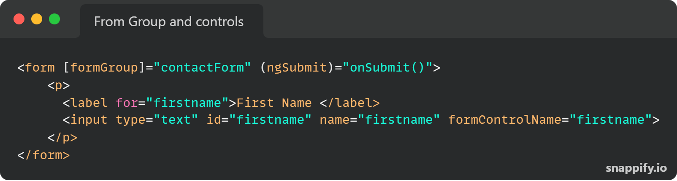
Binding create form In template

Slide 12
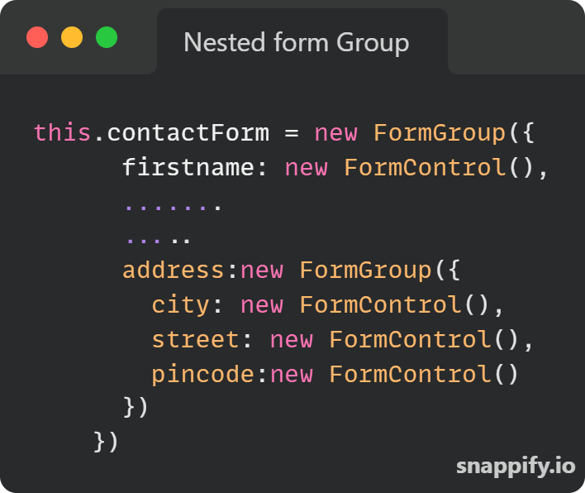
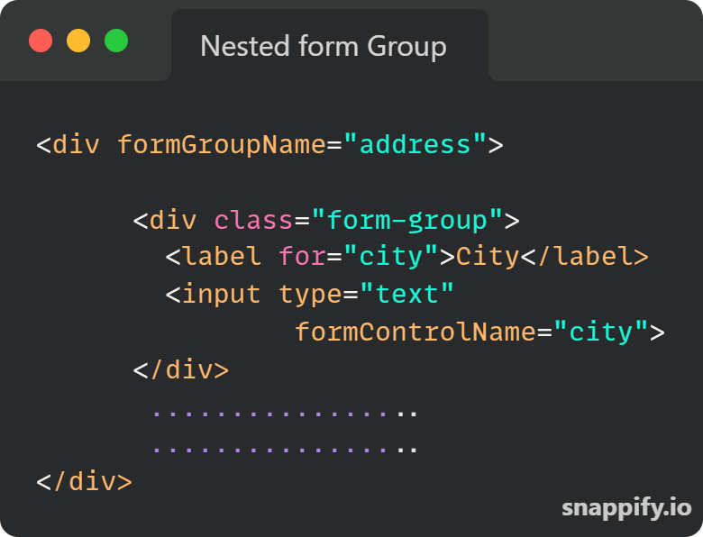
Nested From Group

Slide 13
Common use cases
Load form with default values
Open saved forms
Get form control ref and set value
Reset the form
Listening to form value changes
Set value and patch values

Slide 14
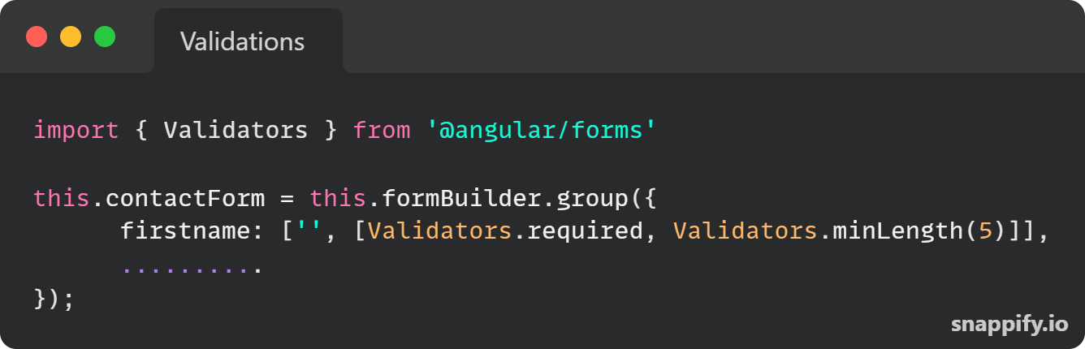
Validations
REQUIRED
MINLENGth
Maxlength
Email
Pattern

Slide 15
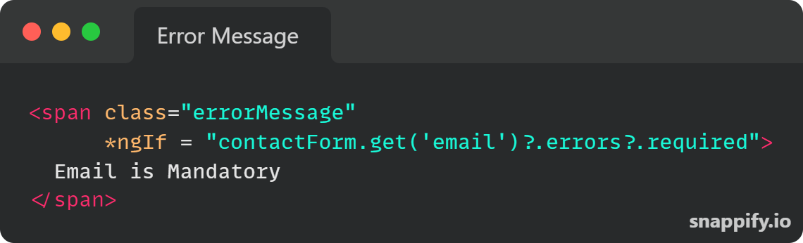
Show error Messages

Slide 16
From control properties
valid: This property returns true if the element’s contents are valid and false otherwise.
invalid: This property returns true if the element’s contents are invalid and false otherwise.
pristine: This property returns true if the element’s contents have not been changed.
dirty: This property returns true if the element’s contents have been changed.
untouched: This property returns true if the user has not visited the element.
touched: This property returns true if the user has visited the element.
Source : https://stackoverflow.com/questions/25025102/angularjs-difference-between-pristine-dirty-and-touched-untouched

Slide 17
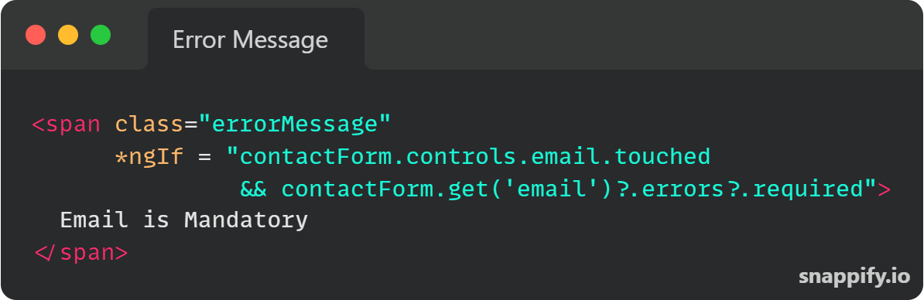
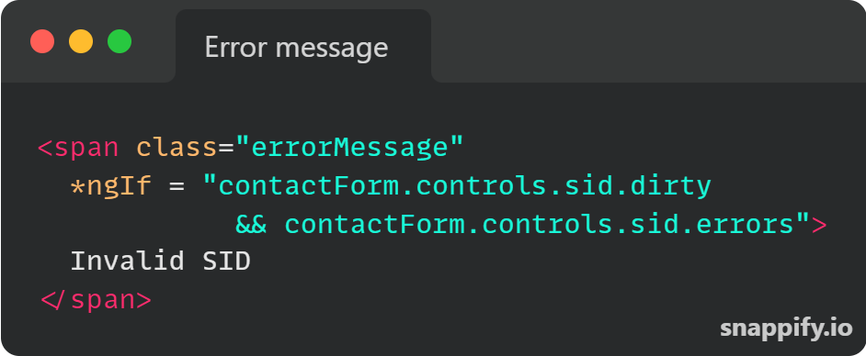
Show error only after field is touched/Dirty

Slide 18
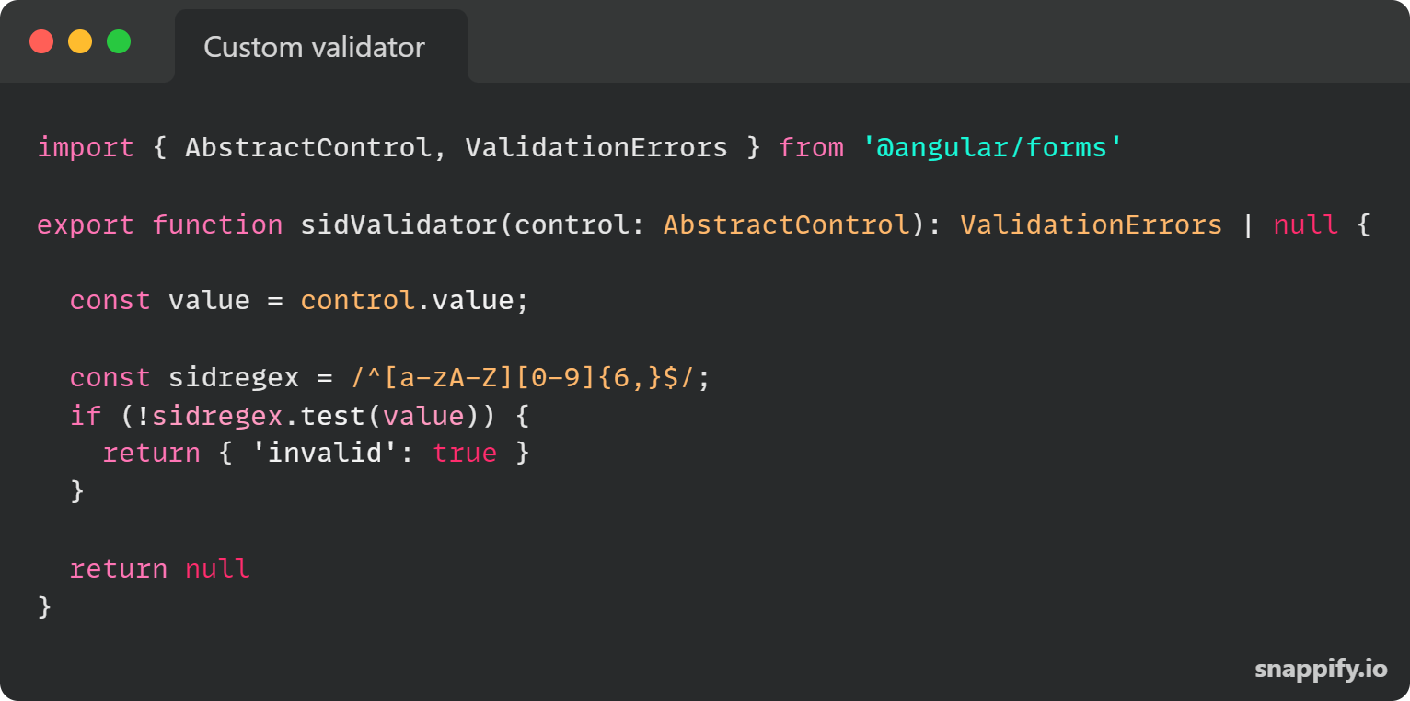
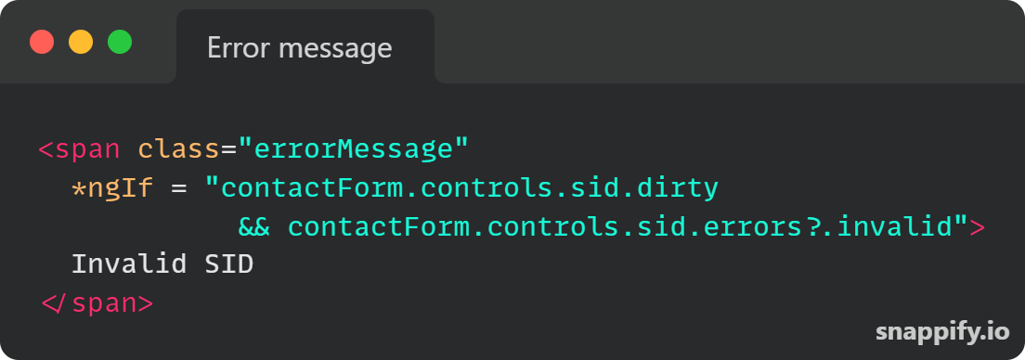
Custom validator

Slide 19
Custom elements in form group
CONTROL Value accessors
under the hood, the Angular forms module is applying to each native HTML element a built-in Angular directive, which will be responsible for tracking the value of the field, and communicate it back to the parent form.
These directive are called control value accessors
Methods
writeValue
registerOnChange
registerOnTouched
Setdisabledstate

Slide 20
